Slide 1
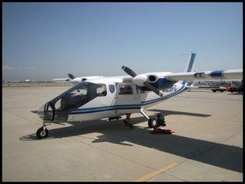
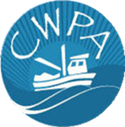
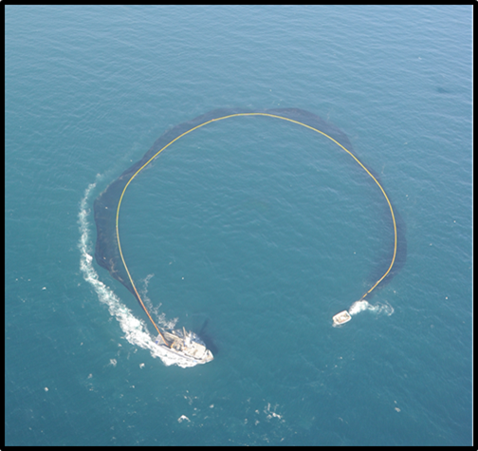

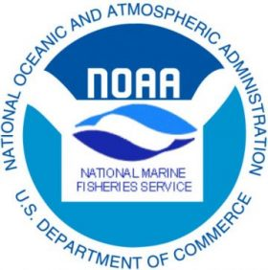
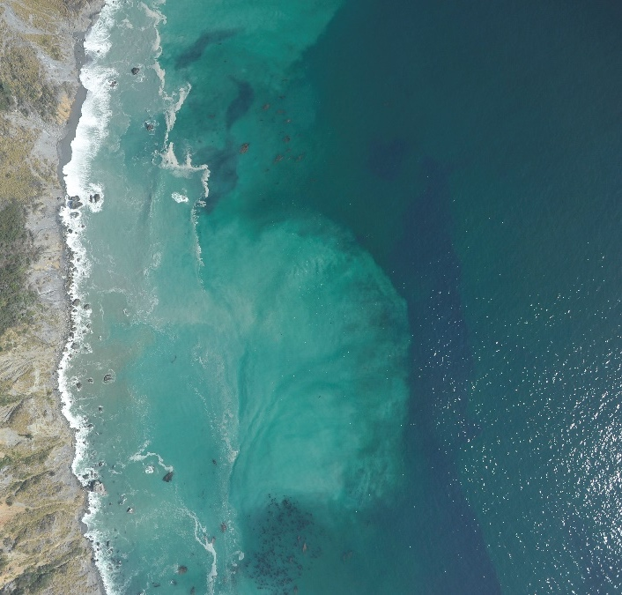

Collaborative Aerial Surveys for Nearshore Coastal Pelagic Species
CDFW Science Symposium
Diane Pleschner-Steele, CA Wetfish Producers Association
Kirk Lynn, California Department of Fish and Wildlife
Emmanis Dorval, Lynker Technologies/NOAA Fisheries Southwest Fisheries Science Center
Notes:
I’m Diane Pleschner-Steele, Executive Director of the Non-profit California Wetfish Producers Association. We represent the majority of California’s historic “wetfish” industry. Our partners are Kirk Lynn from the California Department of Fish and Wildlife, and Emmanis Dorval from NOAA Fisheries, Southwest Fisheries Science Center.
We’re pleased to share information about our collaborative nearshore aerial surveys.

Slide 2
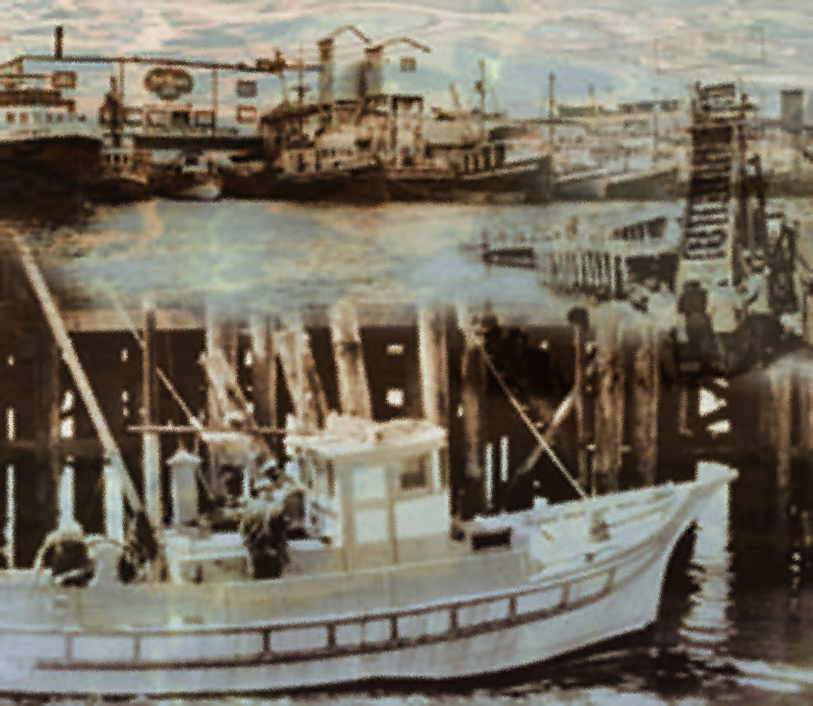
Outline of this Presentation
Background
  Wetfish Industry
  CPS Fishery Management
Aerial Survey
  Origins
  Research Goals & Methods
    Validation of aerial estimates
    Spatial replication
  Coastal Surveys
Results
Future plans
Benefits of Collaboration
Notes:
We will present a very short history of California’s wetfish industry, fishery operation and management.
Then we’ll discuss the nearshore aerial survey – its origins, research goals and methods. We’ll follow up with examples of our survey results, future plans and the positive benefits to California’s wetfish industry.

Slide 3
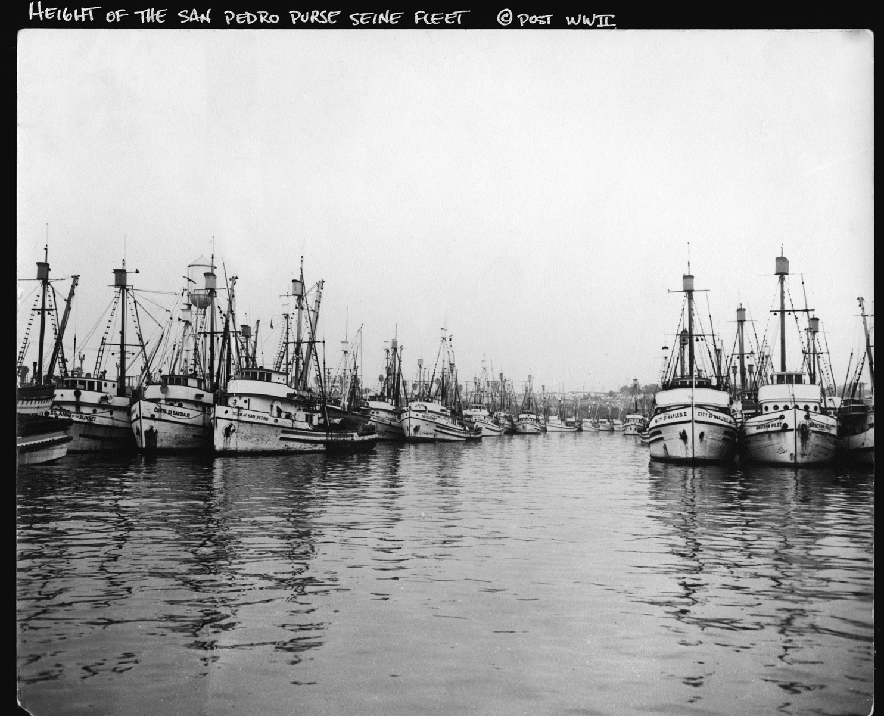
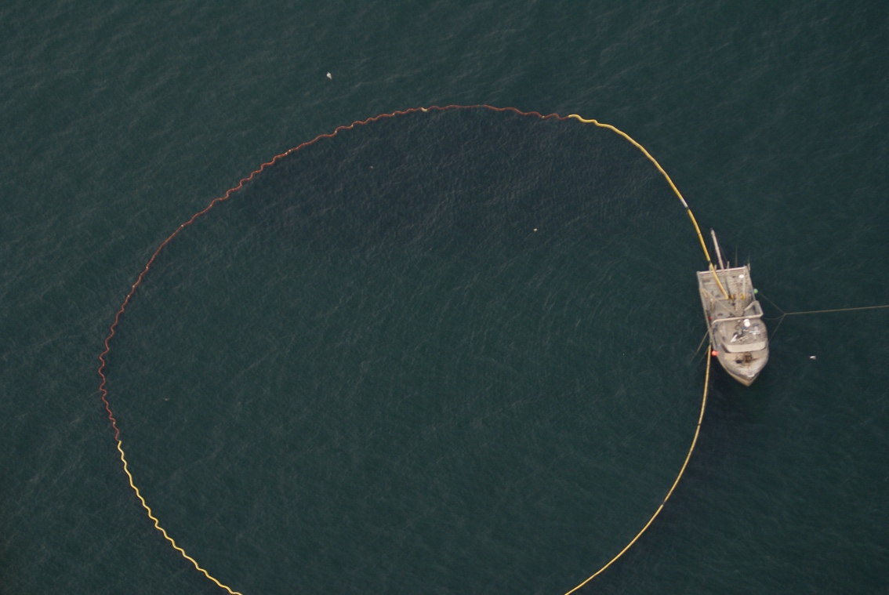
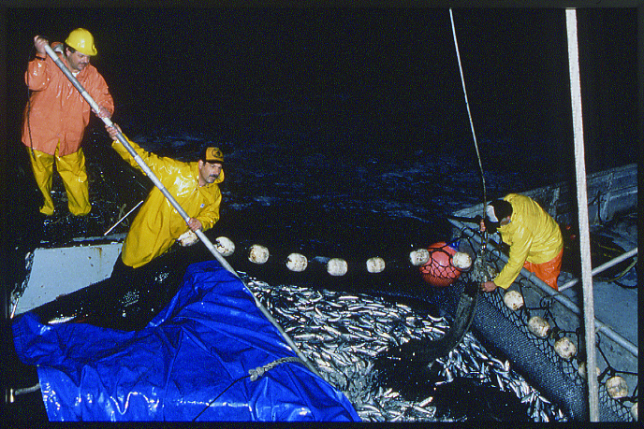
Background - CPS Fishery and Management
Coastal Pelagic Species (CPS)
  AKA “wetfish”
  Sardine, Anchovy, Mackerels, Squid
CPS Fishery History
  Fleet
  Methods/Gear
CPS Fishery Management
  PFMC
  CPS FMP
NOAA/SWFSC Surveys
  No coverage of nearshore waters
  (where 70+ percent of CA CPS/sardine
  fishery occurs)
Notes:
Sardines are a vital member of the Coastal Pelagic Species (CPS) complex and the foundation of CA’s historic “wetfish” industry. CPS – including sardine, anchovy, mackerels and squid – are called wetfish because historically they were canned wet from the sea, with minimal pre-processing. Sardines were once the largest fishery in the western hemisphere, and the fleet in California numbered more than 300 vessels.
CPS are typically caught using ‘round-haul’ nets. Purse seine nets operate by encircling the school of fish, then a skiff holds the top of the net open while the captain hydraulically draws the bottom of the net closed, like a drawstring purse. Fish are then pumped or brailed into the hold of the vessel.
The sardine resource and fishery collapsed in the late 1940s and early ‘50s and the State implemented a moratorium on directed fishing that lasted for nearly two decades..

Slide 4
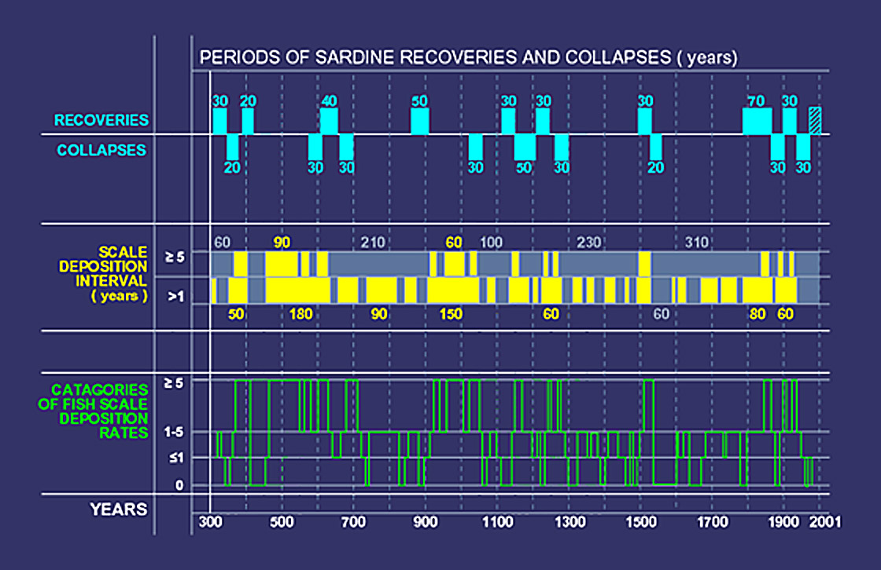
Sardine Cycles of Abundance
Nine major sardine recoveries and subsequent collapses over a 1700-year period
BAUMGARTNER ET AL.: HISTORY OF PACIFIC SARDINE AND NORTHERN ANCHOVY POPULATIONS CalCOFl Rep., Vol. 33,1992
Notes:
Meanwhile, scientists discovered that CPS have dynamic natural cycles of abundance, driven largely by environmental forcing.
Sardines began returning to abundance in the late 1980s, and moved to federal management in 2000 as the population again expanded north of California.

Slide 5
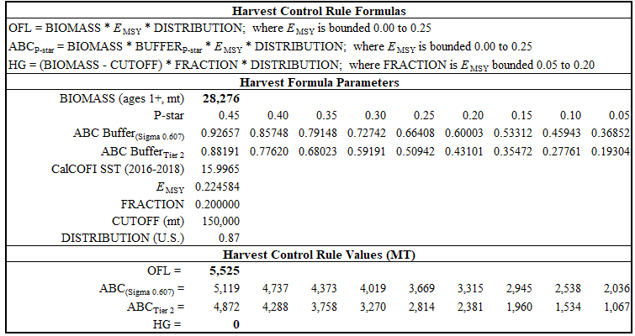
CPS Fishery Management
San Pedro Fleet today Sardine Harvest Control Rule 2020-21
Notes:
The Pacific Fishery Management Council manages the “northern” sardine stock under the CPS FMP, which established a limited entry program for CA CPS fisheries. California’s limited entry CPS fleet now numbers only 65 vessels.
The Council sets sardine quotas based on annual stock surveys conducted by the Southwest Fisheries Science Center.
But NOAA surveys do not extend into nearshore waters, where 70 percent or more of CA’s sardine and anchovy fisheries occur.
And that became a big problem when biomass estimates from sardine stock assessments declined, beginning in 2008.

Slide 6
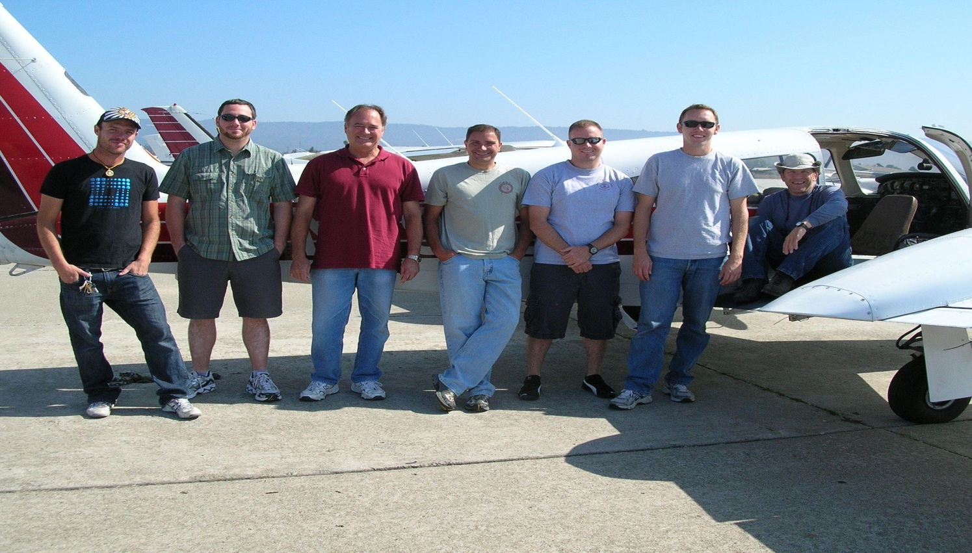
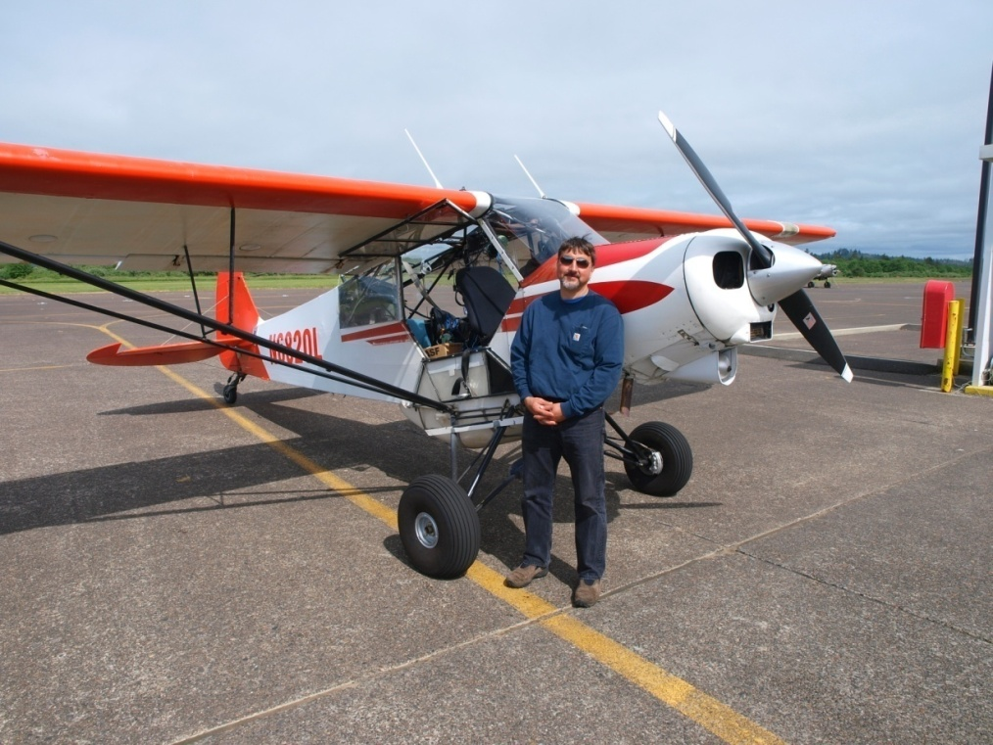
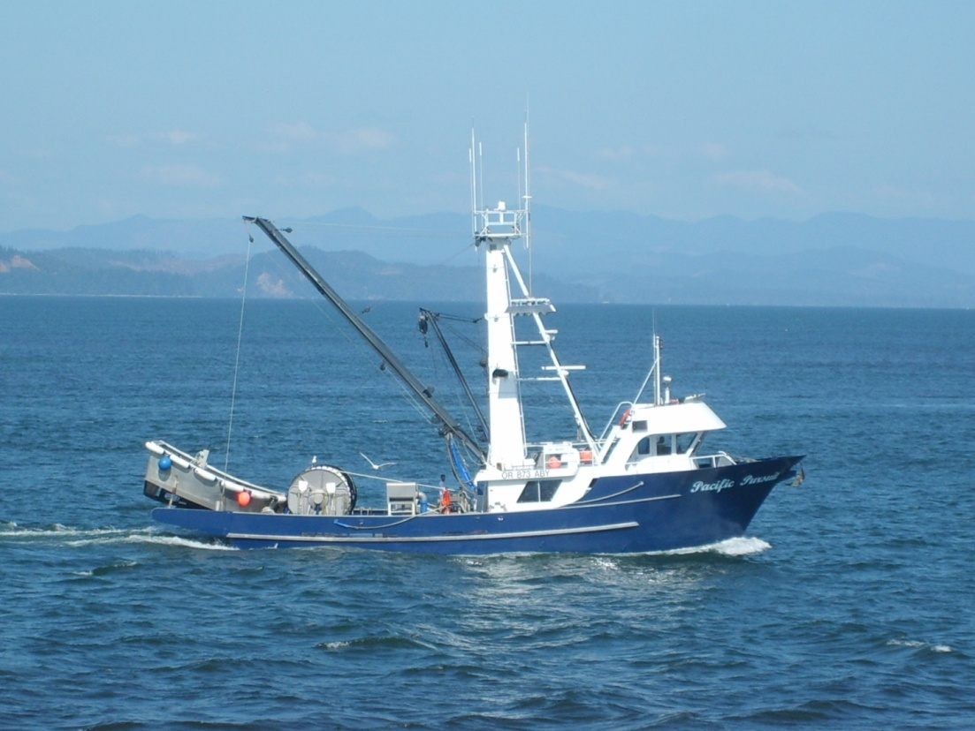
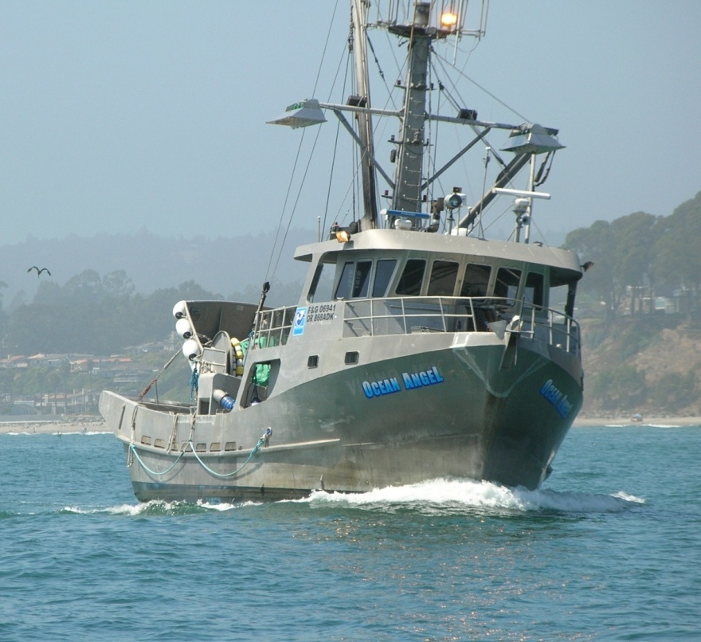
Origins - CPS Aerial Surveys
West Coast Aerial Sardine Survey – A Consortium of the Sardine Industry
Aerial spotter pilots ~
4 planes for CA = 40 transects
1 plane for WA/OR = 26 transects
Aerial camera systems with 60% overlap obtained seamless photographic coverage of transects flown to document spotter pilot estimates of school abundance
4 EFP vessels in PNW – Northwest Sardine Survey, LLC
8 EFP vessels in CA– CWPA
4 in Monterey and 4 in SCA
Permitted to collect sardines in “point sets” to validate spotter pilot estimates
Notes:
As stock assessments and sardine quotas declined, fishing seasons closed early from 2008 onward. So, groups of fishermen in the PNW and CA worked with scientists to develop a coastwide survey plan to document the sardines that fishermen were seeing, with the goal to improve sardine stock assessments.
In 2009 CWPA surveyed Northern CA down to Monterey, and in 2010 we chartered 4 planes and 8 vessels and surveyed both Northern and Southern CA. We were granted Exempted Fishing Permits (EFPs) to catch sardines when the season was closed.

Slide 7
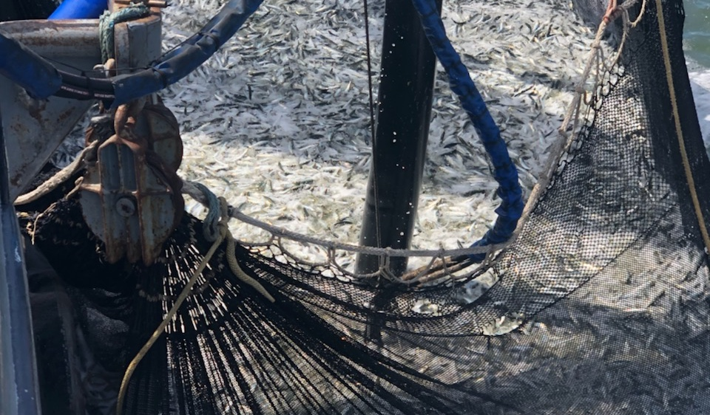
Aerial Survey Goals
Conduct a coastwide aerial survey of Pacific Sardines (and Northern Anchovy) inshore of NOAA surveys
  Pilot flew systematic random transects, photographed schools at 60-80% overlap, then scientists analyzed the photos to determine school surface area and biomass
Conduct “Point Sets” on targeted sardine schools to relate the aerial survey estimates by spotter pilots to sardine abundance/biomass actually landed
  Fishermen were required to keep each school in a separate hatch. Fish were landed, weighed and measured and biological samples taken
Results were first used in the 2009 sardine stock assessment
CWPA began collaborating with CDFW in 2012
Notes:
Our plan was to fly aerial surveys in both the Northwest and California, inshore of NOAA surveys, The pilots used an aerial camera system to document the schools they saw and estimated, both in size and species composition. We validated pilot tonnage estimates with “point sets” on targeted schools to quantify pilot observations. Fishermen were required to store individual schools in separate hatches. At the dock each school was weighed, measured and biological samples taken.
Aerial survey data were first used in the 2009 stock assessment, and again in 2010, and the surveys led to an increase in the catch limit.
In 2011 CWPA could not afford to conduct another aerial survey and the Northwest had trouble too, so aerial surveys were dropped from the stock assessment. But CDFW offered to provide a plane and collaborate to continue the nearshore surveys, and we began partnering with the Department in 2012.

Slide 8
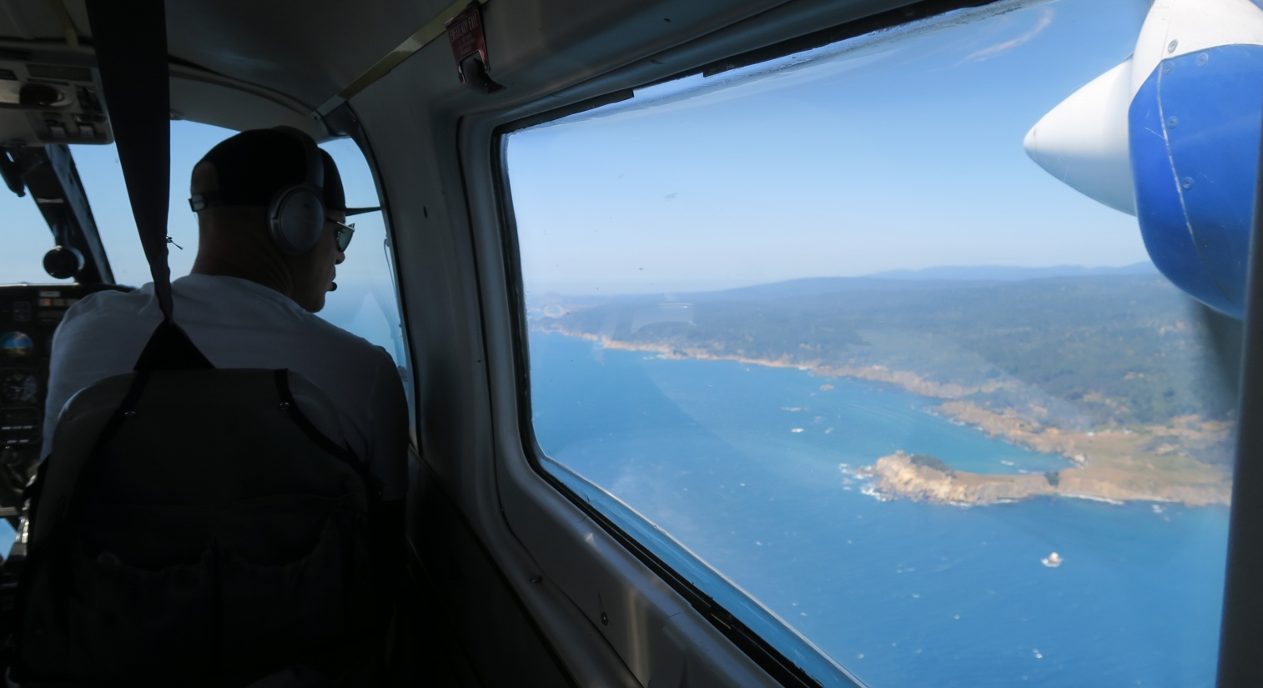
CWPA Collaboration with CDFW
California Coastal Pelagic Species Survey (CCPSS)
  Began 2012 in southern CA for Sardine; Anchovy added to survey in 2013
    Directed sardine fishery was closed in 2015 after biomass estimate fell below 150,000 mt
2017 Aerial Survey Methodology Review
2017 Aerial Survey expanded to include Northern CA
Nearshore Cooperative research - August 2018
  Develop variance estimator
    Replicate Transects flown
  Validate observer tonnage estimates
    Point Sets (biological data)
Bias correction factor derived
Notes:
The CCPSS survey began for sardine in S.CA.
This is the timeline of progress in our collaborative research.
We continued collaborating after the directed sardine fishery was closed in 2015, when the age 1+ biomass estimate fell below 150,000 mt.
In 2017 the aerial survey underwent a methods review at the Pacific Fishery Management Council, and survey methods evolved to incorporate recommendations from the Council’s Science and Statistical Committee (SSC):
1) to fly replicate transects to analyze variance, and
2) to validate spotter pilot tonnage estimates with more point sets.
Research on these began in August 2018.
With help from SWFSC Emmanis Dorval, CDFW developed a bias correction factor to apply to spotter pilot survey biomass estimates.

Slide 9
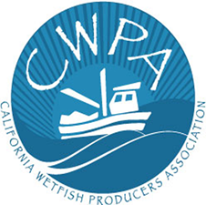
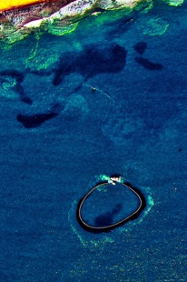
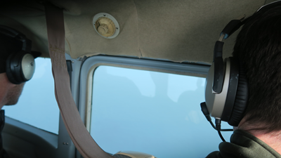
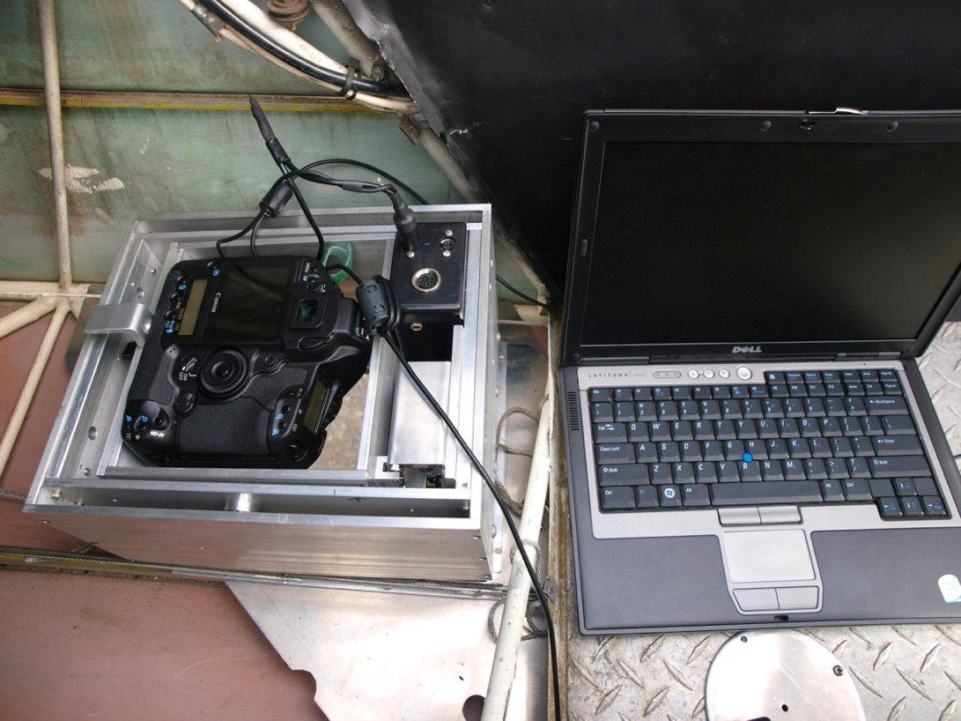
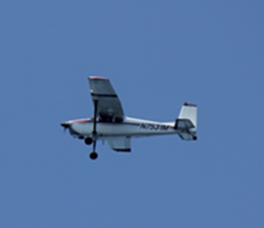
CWPA Contributions to Collaborative Research
Charter Spotter Pilot to fly and
Observe in CDFW plane
Aerial Camera System
Mfr. Aerial Imaging Solutions
Nikon D-900 DSLR Lens 21 mm
Laptop PC
Dell latitude D630
Photo system acquires digital images at specified overlap rate (60-80%)
Logs: Altitude, GPS Position, Time, Observer Comments
Charter Fishermen to conduct “point sets”
FV Eileen wrapping a 20 ton sardine school
Charter Spotter Pilot with own plane
to set fishermen on targeted schools
Notes:
CWPA has contributed to this work since 2012 by supporting:
A spotter pilot as observer in the CDFW’s plane for coastal aerial surveys. We also chartered the pilot in his own plane, and a 2nd pilot also flying in the same plane, as well as fishing boats to conduct point sets to validate the pilot’s aerial biomass estimates
We also loaned the Department our Forward-motion compensating aerial camera system – to document and record the position of fish observations

Slide 10
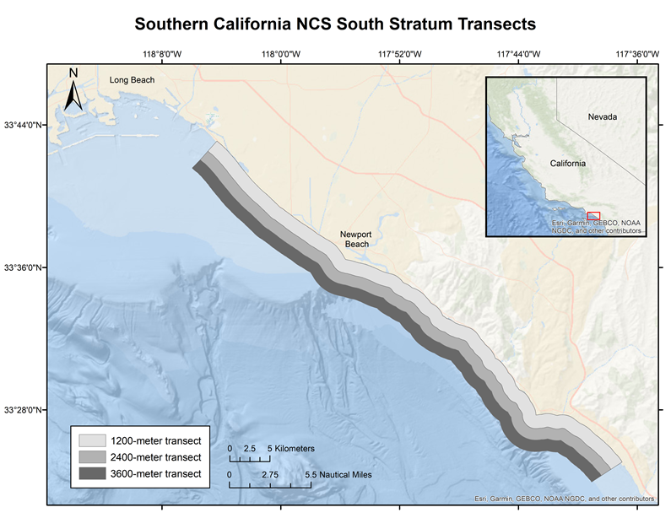
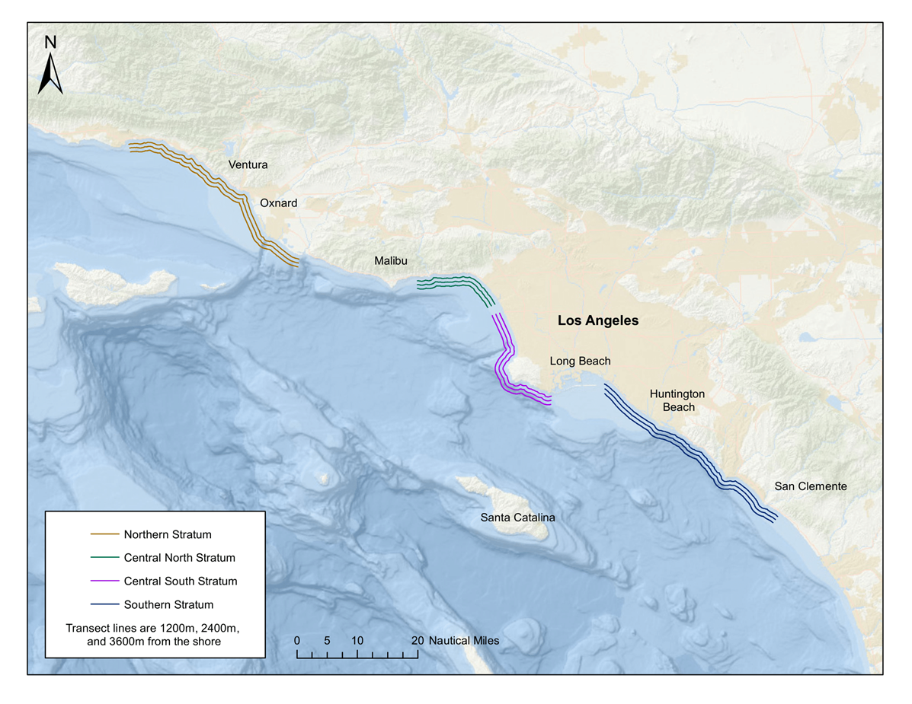
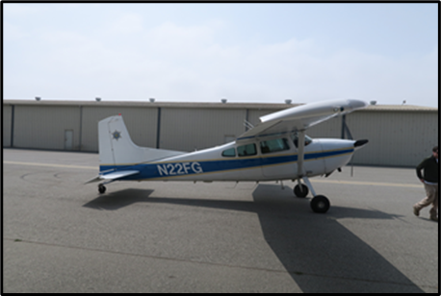
Replicate Transects in Surveys
Notes:
A primary goal from the Methods Review was to develop a variance estimate for CPS biomass.
The left panel shows detail for one stratum, and the right panel shows the position of 4 research strata in S.CA.
There are three bands or survey transects – each is flown three times. This way scientists can look at the variance of the fish tonnage observed among and within transects.
Each band = 1,200 m wide, so the aerial survey covers waters from shore out to 3,600 m.
The SSC agreed that it was ok to use “among transect” data to calculate variance for aerial survey biomass estimates.

Slide 11
Calibration Data: Point Sets - Sardine
Notes:
Scientists developed a table of school sizes and number of schools of each size that should be caught in point sets to develop a calibration curve for pilot biomass estimates.
This is a summary table of point sets collected so far for sardine.
We are working to collect more data in S CA for larger (80+ mt) schools, and in Monterey for schools of all sizes.
We’re also working to expand and improve data collection for northern anchovy
We are submitting another EFP application requesting authorization to capture 300 mt of sardines for point sets in 2022-23, because the directed fishery is still closed.
Point set data are valuable both for validating observer tonnage estimates and species ID (including mixed schools), and and for providing biological information for stock assessments through collected samples.

Slide 12
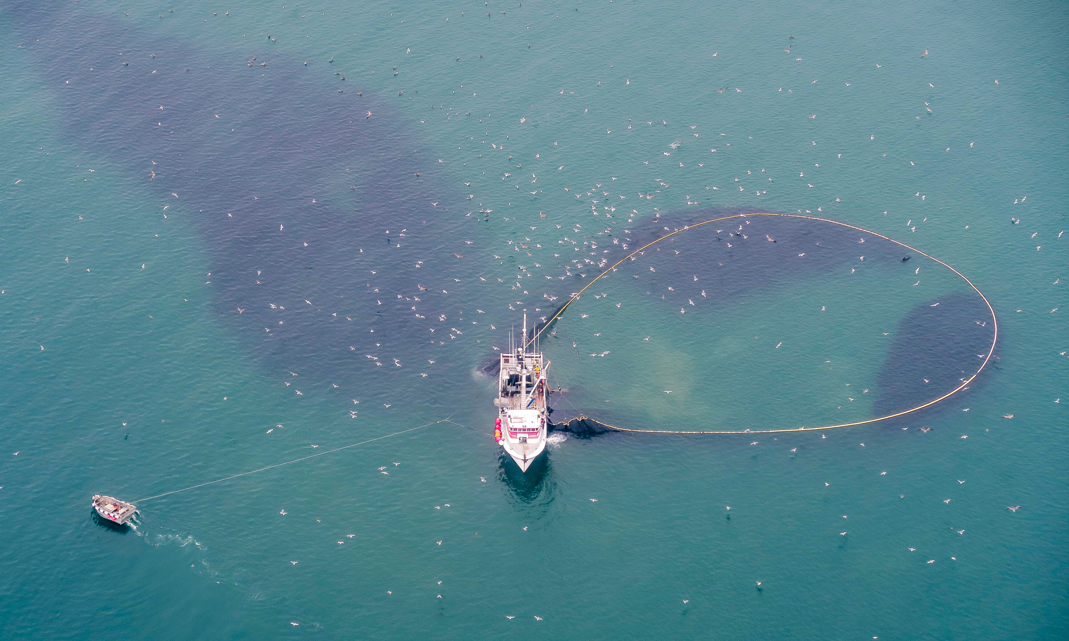
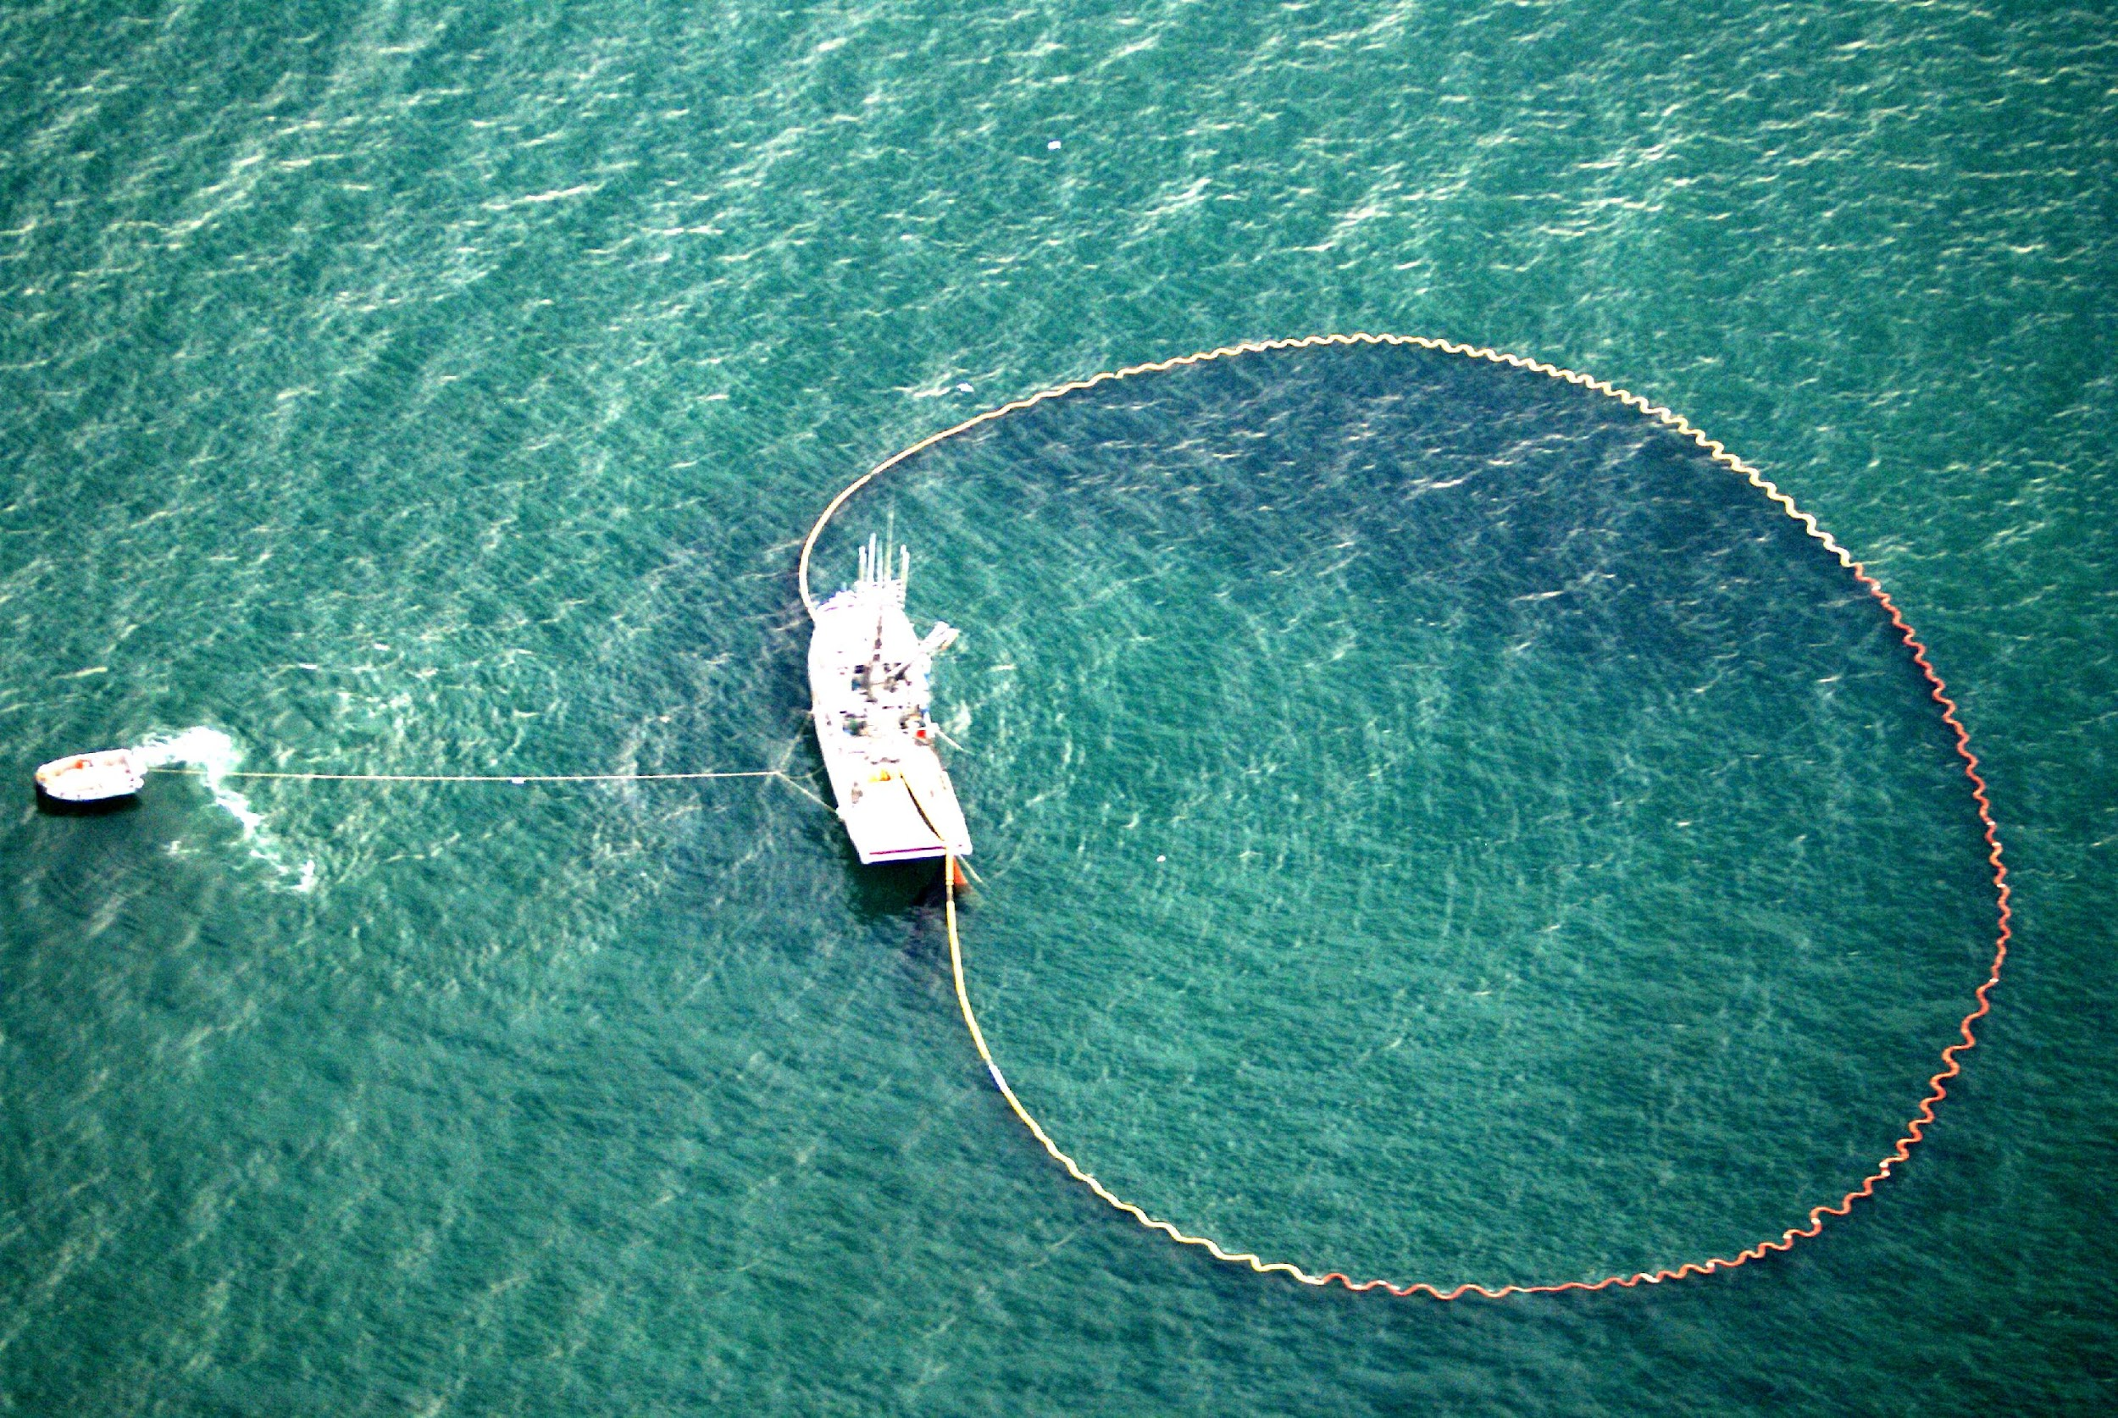
Methods - CPS Schools Captured in Purse Seine Net
Anchovy set
Valid Sardine point set
(enhanced photo)
Notes:
Here are photos of the purse seine catch method used for point sets. The pilot directs the fisherman to a school, and communicates the position of the fish to the vessel as the vessel encircles (or wraps) the school with the seine net. Both the pilot, co-pilot and fisherman provide independent estimates of tons captured and the percent of the school captured. Point sets count as valid only if near 100% of the school is captured.
At the dock, samples are taken from the landed catch to determine species composition, and the catch is weighed.
From these point sets, pilot tonnage estimates are compared with actual landed weight to develop a bias correction factor that is then applied to field survey data.

Slide 13
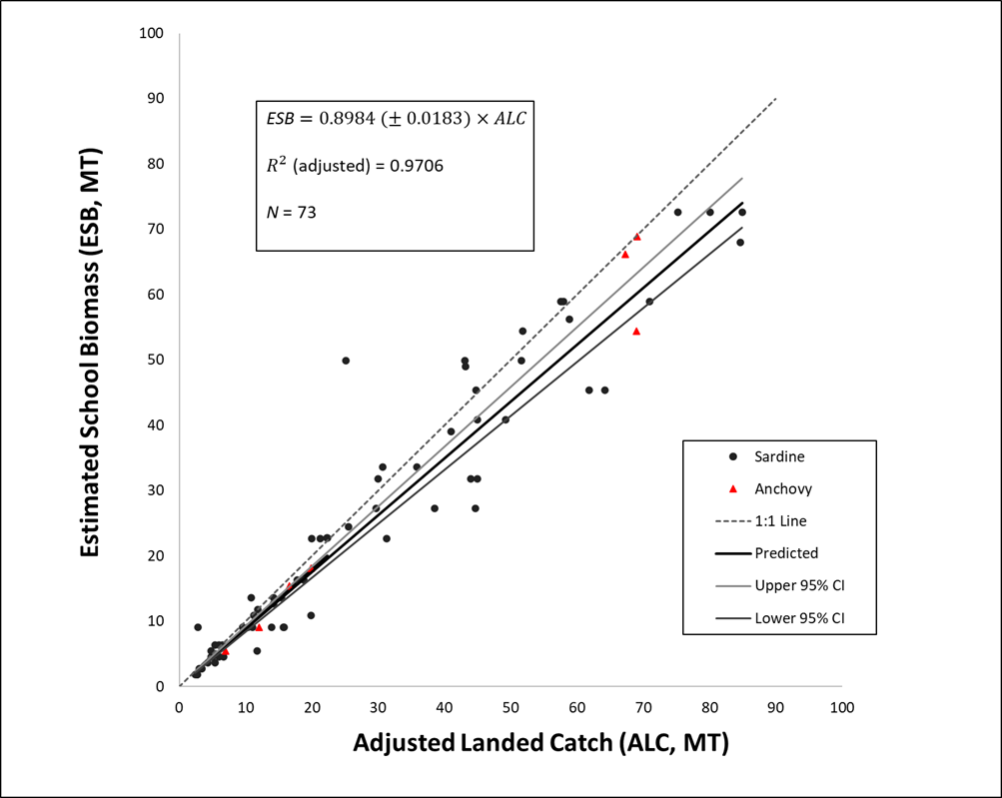
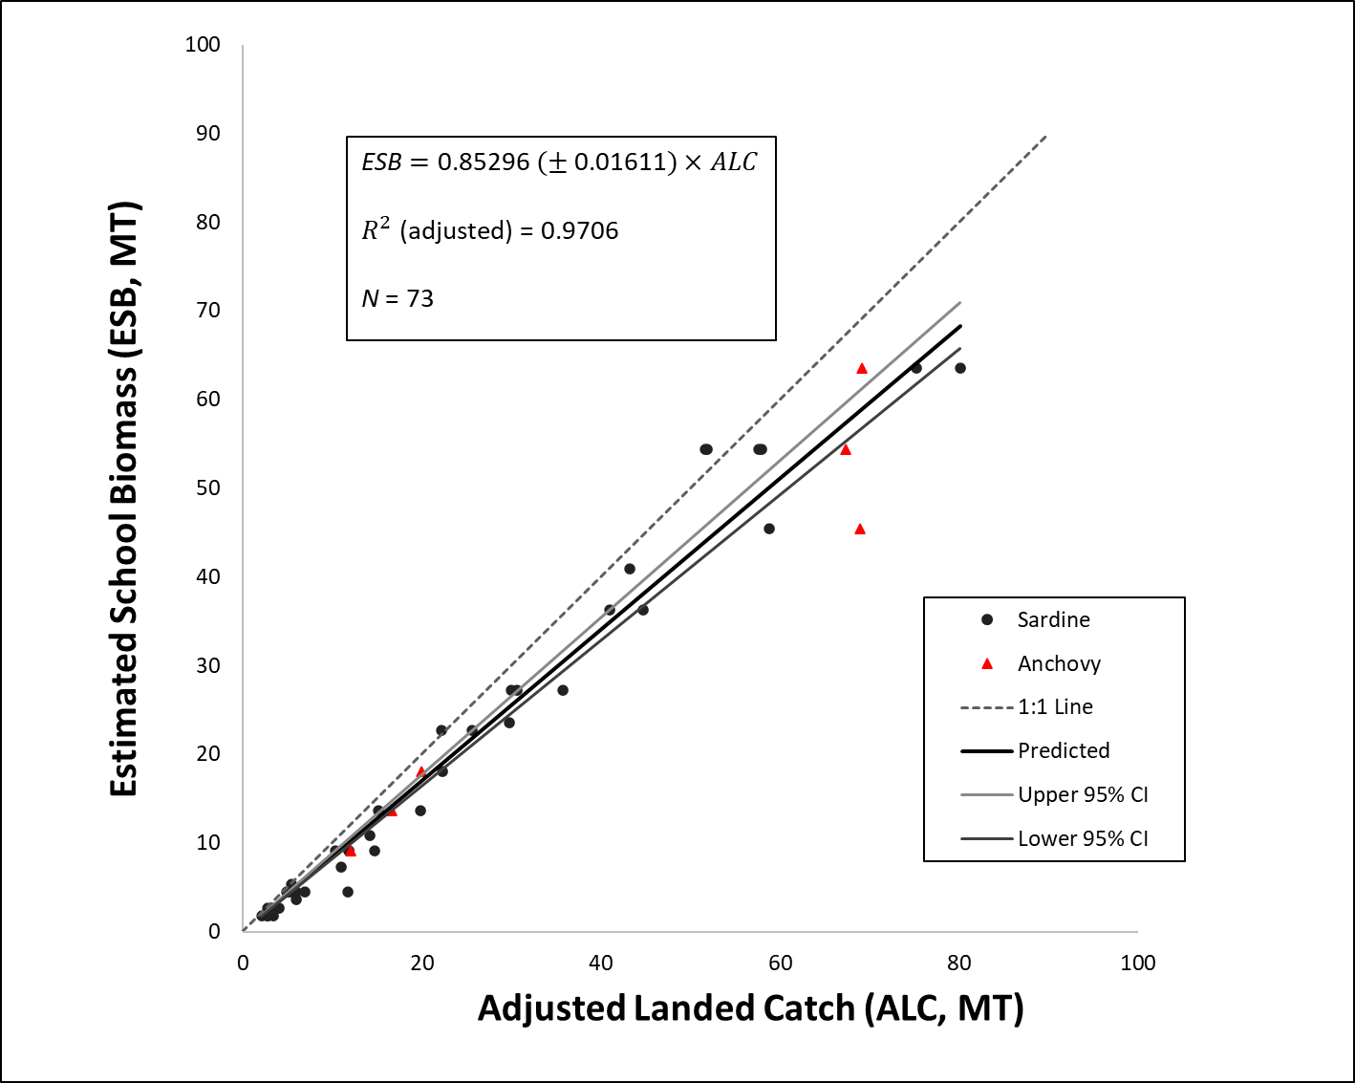
Calibration Curves
Spotter 1
Spotter 2
Notes:
These are calibration curves for both (spotter 1) and (spotter 2). The Y-axis = pilot tonnage estimates, X-axis = landed measured catch weight.
We have more data points for spotter 1, since he was also part of 2010 industry aerial survey. Spotter 1 also flies as observer in the CDFW plane.
Based on point set estimates, Spotter 1 predictions are about 90% accurate and tend to underestimate actual school biomass.

Slide 14
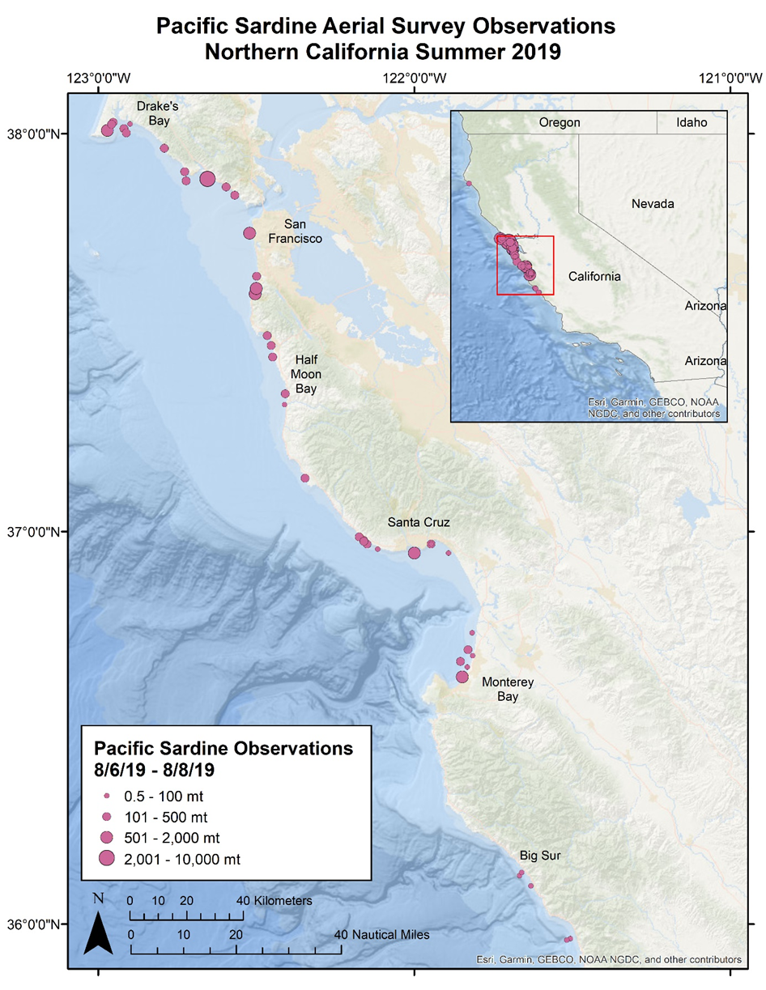
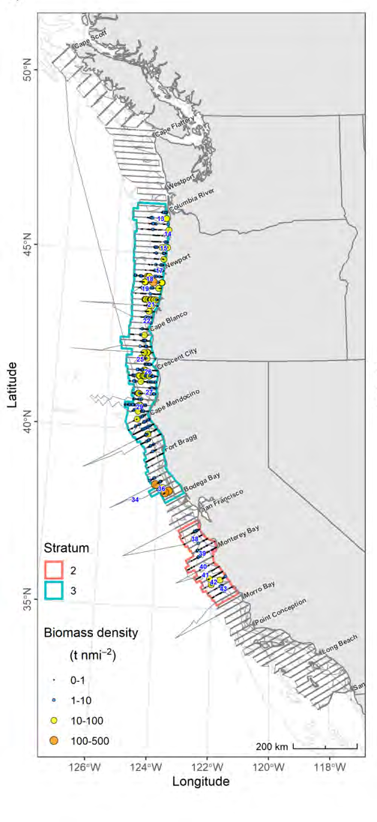
CCPSS Survey Results - 2019
AT Stratum 3:
94% (31,695 mt) of sardine
Aerial: 12,279 mt
Notes:
The left figure on this slide shows the summer 2019 NOAA Acoustic Trawl survey map for the core area (offshore), with CDFW’s nearshore survey area highlighted. The right figure shows CDFW aerial survey sardine observations.
During the months of July and early August, the AT coastwide survey observed 94% of sardine from from near the Columbia River in OR to Bodega Bay in N CA. (31,695 mt)
In early August the CDFW Nearshore Aerial Survey observed 12,279 mt of sardine in northern CA – between Drake’s Bay and Big Sur.
There was minimal double-counting between the two surveys. The CCPSS estimate (12,279 mt) was ~ 27% of the total sardine biomass when combined with the AT estimate (33,362 mt).
The NOAA AT survey apparently “missed” thousands of tons of sardine that year. That was significant because 2019 was the year that northern sardines were declared "overfished," as the biomass estimate fell below 50,000 mt.
Fig 18 TM 626

Slide 15
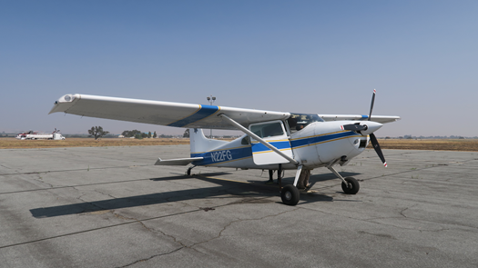
Results - 2017-2021 Aerial Observations
* Aerial surveys coordinated with offshore NOAA acoustic-trawl survey
Notes:
Here is a summary of aerial survey observations since 2017 that were coordinated with offshore acoustic-trawl surveys.
CDFW now strives to conduct aerial surveys at the same time as NOAA offshore surveys.
Sardine disaster relief funding has enabled CWPA to support the Department’s aerial survey with camera and spotter pilot and also to charter vessels to collect point sets and biological samples as allowed by our EFPs.

Slide 16
Use of Aerial Biomass Data in 2020 Sardine Assessment
CDFW Aerial Survey data used to inform catchability (q) of the AT survey (how much of the age 1+ sardine biomass the AT sees)
2019 CCPSS Survey – 12,279 mt sardine
2019 AT Survey – 33,632 mt sardine coastwide
Sardine age 1+ model projection for 2020 management year
= 28,277 mt.
SSC CPS Subcommittee members acknowledged in 2022 sardine update that biomass is likely underestimated
                Still underestimated according to fishermen, but the precedent set by accounting for nearshore biomass is a step in the right direction
Notes:
CDFW aerial survey data were presented at the 2019 sardine Stock Assessment Review Panel meeting. The STAR Panel recognized that the aerial survey data represent nearshore sardine in CA that the AT survey misses. Aerial data were used to adjust the catchability (q) of the AT survey, which is the primary data input into the stock assessment.
Use of the Department’s aerial survey data set a precedent to include a nearshore correction factor in future stock assessments -- and it resulted in a 30% increase in the AT survey estimate, even though the aerial estimate covered only a few hundred miles of coast, limited by persistent fog.
The draft 2022 sardine update assessment reviewed recently by the SSC Subcommittee acknowledged that the “northern” sardine stock is likely under-estimated
Aerial survey data were also presented and used in the 2021 northern anchovy stock assessment in a similar way, to adjust for offshore survey catchability.
This is a good beginning!

Slide 17
Aerial Survey Challenges
Mother Nature
  Fog, wind and ocean swell can and often do hamper aerial surveys
  Fish surface in variable patterns and only in certain ocean conditions
    If fish not in top 10 meters, aerial spotter can’t see them
    Fishermen often see fish on bottom that pilot can’t see from air
Fish behavior
  Trying to catch CPS / sardines in daylight is challenging in CA
    (fishing usually takes place at night)
  Trying to wrap 80-100% of school in daylight is VERY challenging
    Fish can see and avoid the net and outrun the boat
Logistics
  Coordinating all the pieces at the ‘right time’ is challenging
    Need flexibility to run when weather is right and fish are ‘up’, but…
      CDFW needs to schedule plane in advance
      NOAA also needs to schedule AT surveys a few years in advance
      Spotter pilot and vessels also face scheduling challenges
Notes:
Conducting the aerial survey poses unique challenges - Mother Nature is unpredictable, so is Fish behavior -- sardines only surface during certain conditions, and attempting to wrap the entire school during daylight is VERY challenging!! That’s why most CPS fishing in CA is done at night.
Logistics also are challenging… We now attempt to time aerial surveys in conjunction with NOAA AT surveys, but the NOAA ships are scheduled years in advance. CDFW also needs to schedule plane time in advance with no consideration of weather. And pilots and fishing vessels also face scheduling challenges.

Slide 18
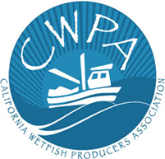
How Collaboration Benefits the Wetfish Industry
CDFW aerial survey has helped to improve sardine stock assessments
  Aerial surveys documented fishermen’s observations in CA
    Nearshore CPS biomass in CA is now recognized and is beginning to be accounted for in stock assessments
  Aerial survey used as nearshore correction factor in 2020 stock assessment
    Observations from small area resulted in 30% Q adjustment
  Continuing collaboration will improve aerial surveys and biomass estimates
    CWPA is pleased to collaborate to help improve science for both sardine and anchovy
  Improved stock assessments will (hopefully) help to reopen the sardine fishery
    And will document anchovy inshore of NOAA AT surveys
  We thank CDFW and the SWFSC for their dedication and support!
Notes:
Despite the challenges, our collaborative aerial surveys are helping to improve the accuracy of sardine stock assessments, and will be important in future anchovy stock assessments.
Aerial surveys help to document fishermen’s observations of CPS abundance on their fishing grounds – which are largely inshore of NOAA acoustic surveys.
Our aerial surveys were used as a nearshore correction factor for sardine in 2020, resulting in a 30% Q adjustment
Improving stock assessments will (hopefully) help to reopen the sardine fishery and boost the accuracy of anchovy stock assessments as well.
We extend grateful thanks to both CDFW and SWFSC for supporting this work – helping to improve the science underpinning CPS fishery management.

Slide 19
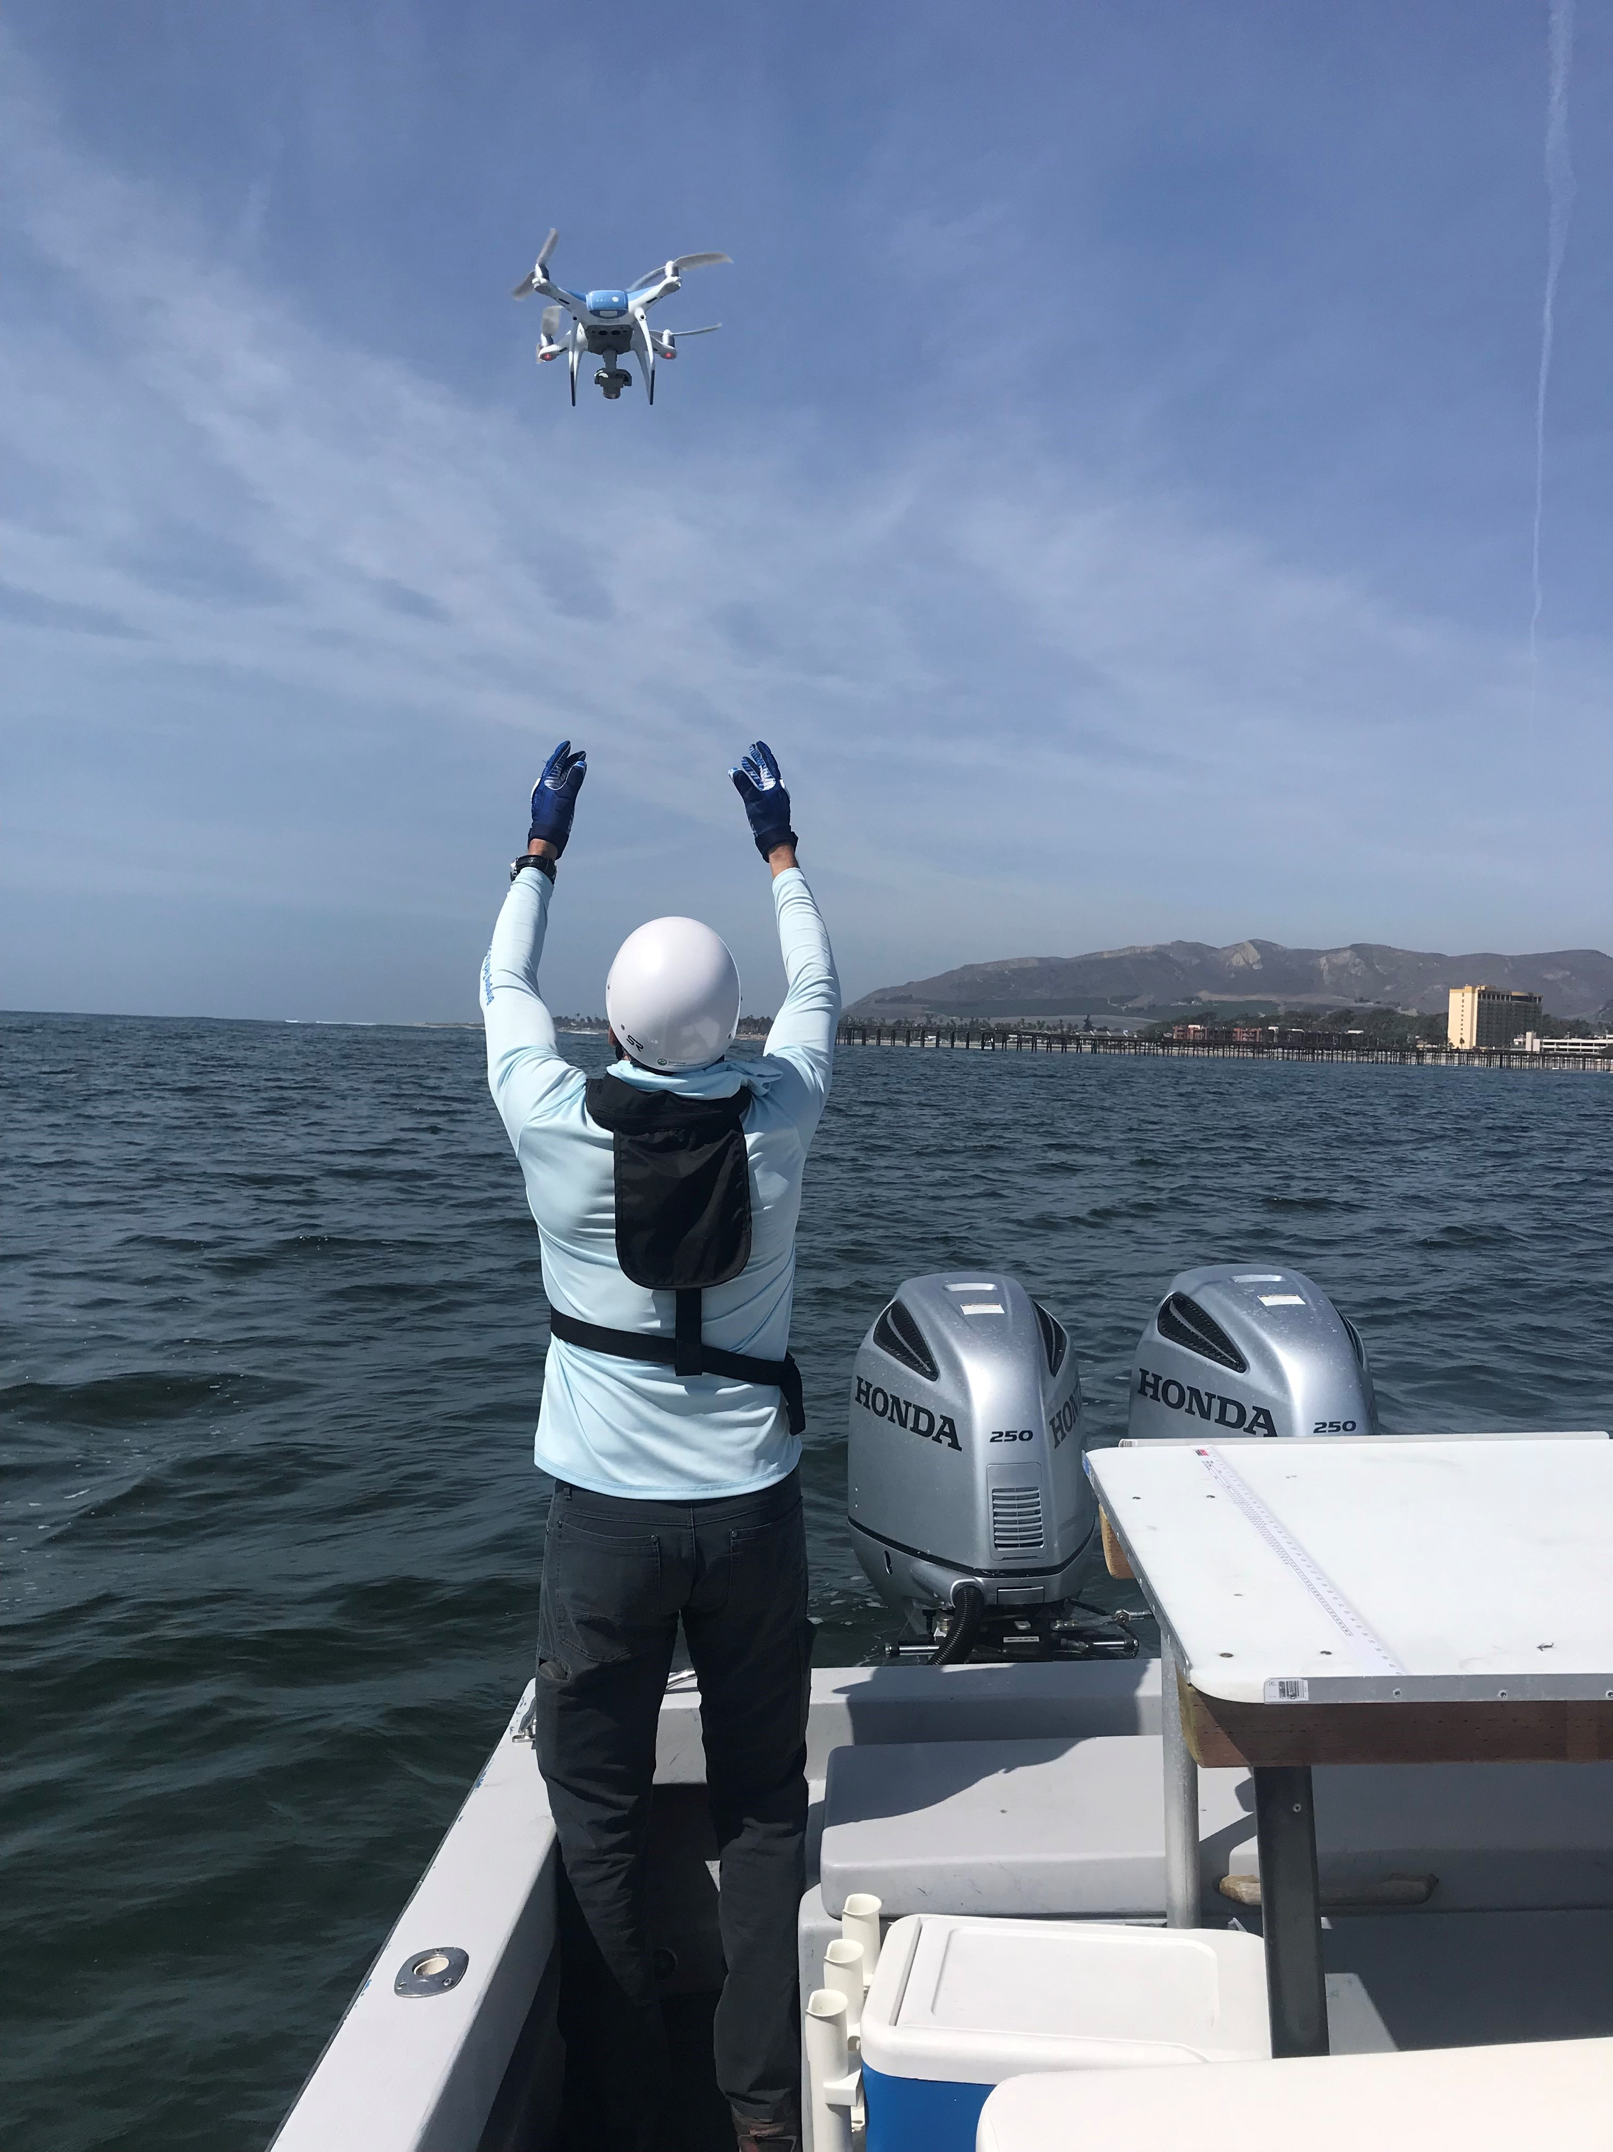
Aerial Survey Research Plans – 2022 and beyond
reproducibility, quality control and sustainability
Aerial survey coordinated with AT survey
Nearshore Collaboration
  Continue point sets in both S CA and N CA
Drone project
  Goal: Examine use of aerial imagery and sensory information to detect, ID, and automate aerial CPS
  biomass surveys
  STAT concerns - reproducibility, quality control and sustainability of aerial survey
Determining YOY anchovy proportions in observations
  Goal: Specialized net to catch small anchovy
  Address SSC concerns – accounting for YOY anchovy
  in aerial biomass estimates
Notes:
We will continue to support CDFW’s aerial survey efforts by providing the camera system and spotter pilot, and chartering vessels to collect biological samples.
We’re cooperating with CDFW in their Drone project, investigating the use of enhanced photo imagery to identify species. This could help to automate aerial survey output, and address reproducibility of aerial survey biomass estimates.
We’re also working to improve aerial estimates of anchovy, especially how to document Young of the Year, or “pinhead” anchovy.
CA’s wetfish industry recognizes the importance of this work, and has earmarked funding from sardine disaster relief mitigation funds in both 2015-16 and 2017-19 to continue this collaboration.

Slide 20
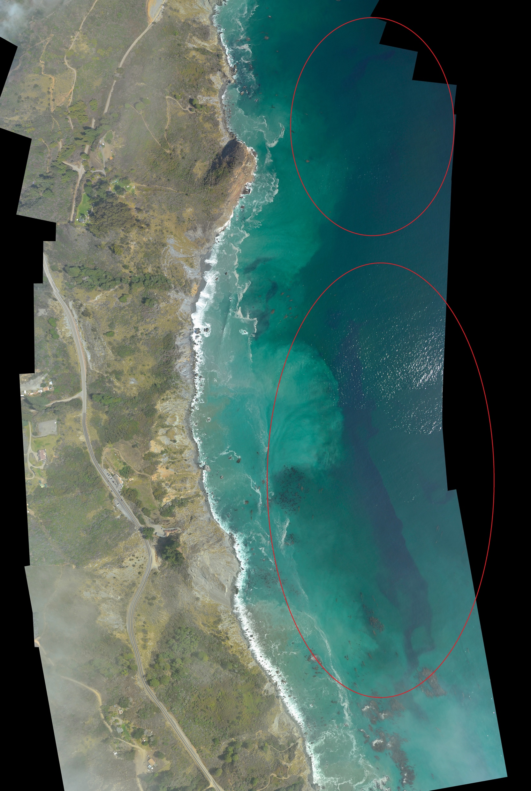
On a perfect day…
4,000 tons of estimated
13,000+ tons sardines
observed near Big Sur ~
Oct. 2018
47% of estimated coastwide biomass of 27,547 mt
Notes:
Here are a couple of examples of the benefits of this survey work: These data were not used in the stock assessment or management at the time, but the 2020 STAR Panel Review set a precedent by incorporating aerial survey data as a nearshore correction factor, so these surveys will be considered in the future.

Slide 21
… on a perfect day ~ another example
58 metric ton sardine
Point Set –4/1/19
“Tremendous amount of fish – too many schools to count”
~ Corbin Hanson
Notes:
. Here’s another example. Persistence pays off!! Fishermen’s nearshore observations are now being acknowledged and quantified.

Slide 22
Acknowledgements
Spotter Pilots – Devin Reed, Andrew White
CWPA Vessel Captains – Corbin Hanson, Nick Jurlin, Jamie Ashley, Pete Ciaramitaro, Anthony Russo, Andy Russo, Neil Guglielmo
CWPA Processors - Vince Torre, Dominic Augello, Lillo Augello, Anthony Tringali, Pete Guglielmo
CDFW Warden Pilots – Mike Breiling, Mike Greenhill, Gary Schales, Kevin Kintz, Tom Evans
CDFW Staff – Dianna Porzio, Trung Nguyen, Katherine Grady, Chelsea Protasio, Erica Mills, Dana Myers, Briana Brady, John Budrick, Michelle Horeczko, John Ugoretz
SWFSC – Kevin Hill, David Demer, Juan Zwolinski
SSC – Andre Punt, John Budrick
Notes:
This research program fits the saying “It takes a village…” We extend grateful thanks to all the people who have contributed to the success of this collaboration.

Slide 23

Questions?
Notes:
I would be happy to answer any questions.

